Slide 1
The Document Object Model and XML
Chapter 10

Slide 2
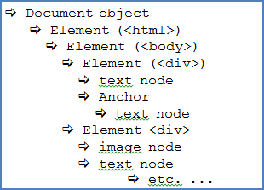
10.1
The Document Object Model: DOM

Slide 3
The Document Object Model: DOM
The Document Object Model (DOM) interface allows programs and scripts to access and modify the content, style, and structure of a document
is platform-neutral (works on any computer)
is language-neutral (can exchange information between any client and a server)
It is an application programming interface (an API)
defines the logical structure of a document
used for both XHTML (and HTML5) and XML documents.
in 1996 the ability to detect user-generated events was limited
known as Legacy DOM - allowed mainly for form validation
Intermediate DOM, was developed in the late 1990s to allow more changes to be made in real time by a user
browser variance continues to be a problem for web developers
World Wide Web Consortium (W3C) began to work on a standardized DOM
first DOM standard, DOM Level 1, was recommended by W3C in 1998
DOM Level 2 was published at the end of 2000
introduced the getElementById() method, included an event model, and support for XML namespaces
In 2004 DOM Level 3 published
by 2005, most popular browsers supported DOM level 3
W3C objective is to provide a standard programming interface through the DOM to use in many different environments and with many different applications

Slide 4
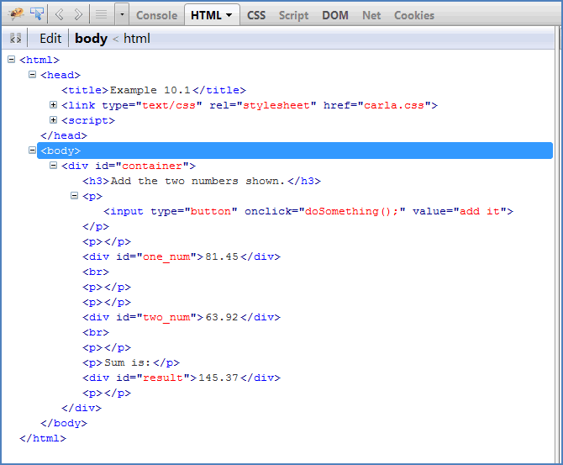
DOM Nodes and Trees
DOM sees an HTML (or XML) document as a tree or as a group of trees.
The document's root element is the <html> element (the primary source)
Can see the node structure with a browser, by inspection:

Slide 5
The Parent-Child Model
some tags cannot be nested within other tags because the DOM identifies some nodes as parent nodes and others as child nodes
A child node can be nested inside a parent node but not the other way around
top level node—the root node—is the top parent node
all other nodes are children of the root
When a node is inside another node, the outer node also becomes a parent
In the previous slide’s image, <html> is the root node so it is the parent of all others
the <body> node is a child of <html>
but the <body> node is also the parent of the container <div>
this <div> is also a child of <body> and a parent of the <h3> node immediately below it
Nodes that have the same level are siblings if they are all inside the same parent
In the example the <head> and <body> nodes are siblings because they are both children of the root and have the same level

Slide 6
DOM Node Object Properties and Methods
Property | Description
childNodes | returns a list of the child nodes for a node
firstChild | returns the first child of a node
lastChild | returns the last child of a node
nextSibling | returns the next node at the same level as this node
nodeName | returns the name of a node, depending on its type
nodeType | returns the type of a node
nodeValue | sets or returns the value of a node
ownerDocument | returns the root element for a node
parentNode | returns the parent of a node
previousSibling | returns the previous node at the same level as this node
textContent | sets or returns the textual content of a node and its children

Slide 7
Some Node Object Methods That Can Be Used with Element Objects
Method | Description
appendChild() | adds a new child node to the one specified, as the last child
cloneNode() | creates a clone of a node
compareDocumentPosition() | compares the position in the document of two nodes
createElement() | creates an element of the type specified
hasAttributes() | returns true if node has any attributes, else returns false
hasChildNodes() | returns true if the node has child nodes, else returns false
insertBefore() | inserts a new child node before an existing (specified) node
isEqualNode() | checks if two nodes are equal
isSameNode() | checks if two nodes are the same node
isSupported() | returns true if specified feature is supported, else returns false
lookupNamespaceURI() | returns the namespace URI that matches a specified prefix
lookupPrefix() | returns the prefix that matches a specified namespace URI
normalize() | joins text nodes that are adjacent and removes empty text nodes
removeChild() | removes a child node
replaceChild() | replaces a child node

Slide 8
The createTextNode() Method
The createTextNode() method inserts a string of text into a text node
Is used to insert text into a node created by a method that appends or inserts nodes
syntax for the createTextNode() method:
var theText = document.createTextNode("text goes here");
Example:
To insert a paragraph node which has the content "This is a new paragraph“:
create the paragraph element and store it in a variable
create a text node with the paragraph text
identify the id of this paragraph node with the setAttribute() method
use the appendChild() method to add it to the page
syntax:
var newElement = document.createElement("p");
var elementId = "new_text";
newElement.setAttribute("id", elementId);
var theText = "This is a new paragraph";
newElement.appendChild(document.createTextNode(theText));

Slide 9
The replaceChild() and removeChild() Methods
The removeChild() Method
The removeChild() method requires that the parent node is specified
The name of the node to be removed is the parameter of this method
The syntax is as follows:
elementNode.removeChild(node_to_remove)
The method will either return the removed node or will return NULL
The replaceChild() Method
The replaceChild() method replaces one child node with another
has two required parameters—the new node and the node to be replaced
The syntax is as follows:
elementNode.replaceChild(new_node, node_to_be_replaced)
The method will either return the replaced node or will return NULL

Slide 10
The childNodes Property
The childNodes property returns a NodeList
The list contains the child nodes of a selected node
If the node selected does not have any child nodes, the NodeList contains no values
The syntax to use this property is as follows:
elementNode.childNodes[]
The brackets contain the index value of the node you wish to identify

Slide 11
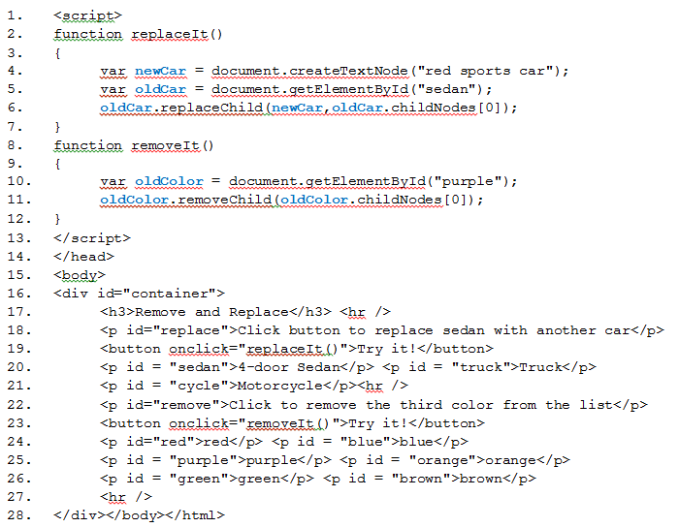

Slide 12
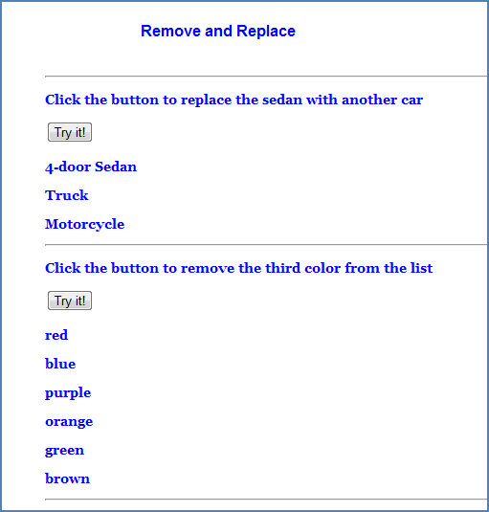
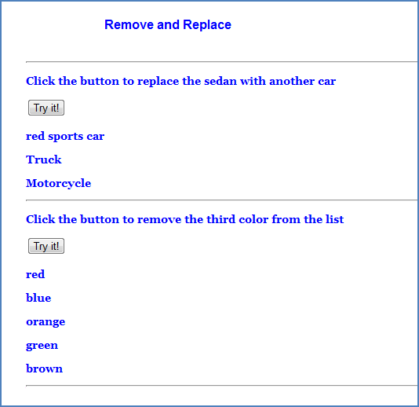
Results of code
The page initially looks like this:
After clicking both buttons, the 4-door sedan is replaced by a red sports car and the color purple has been removed from the list of colors:

Slide 13
10.2
Using DOM Methods with Timers and Styles

Slide 14
The setAttribute() and getAttribute() Methods
The setAttribute() method sets the type attribute of an input element
adds a specific attribute to a value input by a user and gives it the specified value
syntax is:
element.setAttribute(name_of_attribute, value_for_attribute)
The getAttribute() method returns the value of the attribute you specify
takes one argument, the specified attribute
syntax is:
element.getAttribute(name_of_attribute)

Slide 15
The setInterval() and clearInterval() Methods
The setInterval() method begins a timer which will execute until the clearInterval() method is evoked
These methods are of the window object
The setInterval() method calls a function or an expression which will execute at intervals specified by the programmer
It will continue to do this until either the clearInterval() method is called or the window is closed
The intervals must be in milliseconds
to have a function called every two seconds, the time interval is 2000.
The syntax is: setInterval(function_called, milliseconds)
The clearInterval() method clears a timer that has been set with the setInterval() method
has one parameter—the identifier used to identify the setInterval() method
The syntax is: clearInterval(id_of_setInterval_method)
To use a timer, must create a variable (the identifier for the setInterval() method)
If this identifier does not have a value—i.e., has a NULL value--the setInterval() method will not continue.

Slide 16
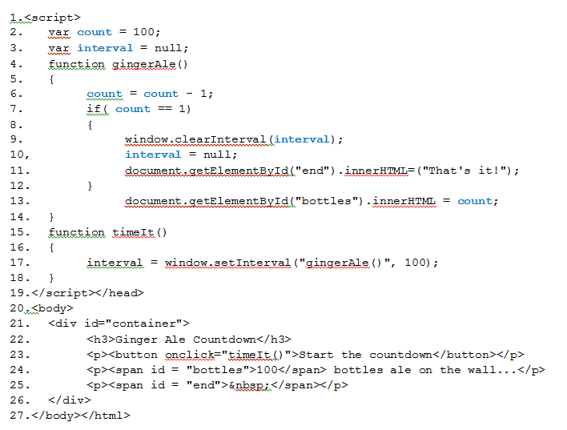

Slide 17
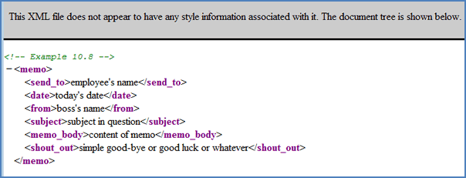
10.3
XML Basics

Slide 18
What is XML and Why do We Need It?
eXtensible Markup Language
You create your own tags and can manipulate elements in many ways
XML is readable by humans and machines
Can be used with databases and other application programming interfaces
XML was designed to transport and store data
suited to developing programs to run on the Internet
allows data to be self-describing: we define our own nodes and tags for elements
You can create XML elements that limit the type of data an element can contain
You can create custom data structures, based on your needs
XML has a rich set of tools used to link and interchange data between databases and other data structures
includes data-searching capabilities

Slide 19
XML Declaration
XML documents form a tree structure that starts, as an HTML document, at the root.
The root element of an HTML document is the <html> tag.
The first line must always be the XML declaration.
The next line is the XML root element.
An XML declaration looks like this:
<?xml version = "1.0" encoding = "UTF-8"?>
The version is required.
The encoding attribute is not required.
describes the character set that the document uses. If nothing is defined, the default character set is UTF-8

Slide 20
XML Elements
Each XML element consists of three parts and may include a fourth:
a start tag: the name of the element enclosed in < and > symbols
content: data or other elements, as with an HTML tag
an end tag: created like the end tag of an HTML element with a < character, a / (slash), the element name, and a > character
attributes: optional—contains additional information about the element, just as HTML elements can have attributes
XML element names must follow certain rules, as follows:
names can contain letters, numbers, and other characters
names cannot start with a number or a punctuation character
names cannot start with the letters x, m, l in any form (uppercase, lowercase, or any combination)
names cannot contain spaces
tag names are case-sensitive

Slide 21
A First XML Document
There is no information about how to render these tags
The browser displays the document tree
The browser shows this at the top of the display
Aside from not displaying the XML declaration, the display is virtually identical to the code

Slide 22
XML Attributes
XML element attributes are used like they are used in HTML tags
describe or identify XML elements
always contained in the start tag of an element
are case-sensitive
require a value
are referred to as name-value pairs because each must have a name and a value
the name of the attribute is on the left of the equals sign and its value, to the right of the equals sign, is enclosed in single or double quotes
general syntax for two attributes of an element named <my_element> is:
<my_element attribute1 = "value one" attribute2 = "value two">
unnecessary to separate attributes with anything other than a space
can define as many attributes as you want
it may be better to use child elements to describe data

Slide 23
XML Entities
if you use certain characters with special XML meaning inside an element, will get an error
Example: the ">" character indicates the end of an element tag
if it is used within the element name or in an attribute name or value, the parser will interpret it to mean a closing character
if you need to use the ">" you can replace the character with its entity reference
There are five predefined entity references in XML
Entity Reference | Character
&lt; | < (less than sign)
&gt; | > (greater than sign)
&smp; | & (ampersand)
&apos; | ' (apostrophe)
&quot; | " (double quotation mark)

Slide 24
Well-formed XML Documents
XML documents should be well-formed
A well-formed XML document adheres to the following syntax rules:
XML documents must have one and only one root element.
XML elements must have closing tags.
XML tags are case-sensitive.
XML elements must be properly nested using the parent-child model.
Every XML attribute must have a value and the value must be in quotes.

Slide 25
XML Parsers and DTDs
XML parser checks your XML document to ensure the document is well-formed and follows the rules
Parsers are often built into browsers
two types of parsers: validating and nonvalidating
DTD stands for Document Type Definition
It is the schema that defines a document's structure
a schema is an XML document itself and has certain advantages over DTDs when using XML
you can include your own DTD with your XML file
it will define the structure of your XML elements
is a validating parser
a nonvalidating parser will check that the XML document is well-formed but will not check that the structure (i.e., all child elements are included) is sound

Slide 26
XML Internal DTDs
a DTD defines the structure of an XML document
A DTD that you include at the beginning of your XML file is an internal DTD
must include all the elements used in the document
defines the root element and all elements contained in the root
defines those elements in the order in which they must appear
each element must be listed with its type (the type of data it contains) and it must have an ending.
The syntax for an internal DTD is as follows:
<!DOCTYPE root_element_name [
<!ELEMENT element_name (child_element_A)>
<!ELEMENT child_element_A (child_a,child_b,...child_x)>
<!ELEMENT child_a (#TYPE_OF_DATA)>
<!ELEMENT child_b (#TYPE_OF_DATA)>
...
]>

Slide 27
XML External and Public DTDs
can create a DTD that is saved in a separate file like external CSS files or external JavaScript files
must tell the computer where to find the external file and include that line just below the XML declaration
External DTD files normally have the extension .dtd
The syntax for including an external DTD file is as follows:
<!DOCTYPE element_name SYSTEM "path_to_dtd_filename.dtd" >
keyword SYSTEM indicates that this is a private DTD
can include both internal and external DTDs
if both DTDs reference the same element, the one closest to the element (i.e., the internal DTD) overrides the other

Slide 28
10.4
Adding Style and XSL Transformations

Slide 29
Using CSS with XML Documents
Must add styles to define how your elements of your XML document will look
syntax to create a style for an XML element named <subject> that will make all text in this element blue and bold is:
subject {
font-weight: bold;
color: #0000FF;
}
can use all the style attributes that are available for HTML style sheets
must define styles for all elements in your XML page
can link the style sheet to the XML document
syntax to create this link is as follows:
<?xml-stylesheet type = "text/css" href = "stylesheet_name.css" ?>

Slide 30
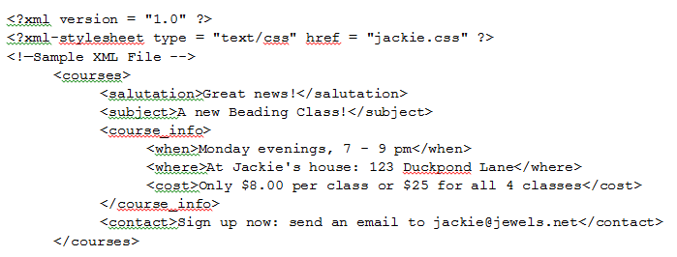
The sample XML file is shown below The next slide shows the attached stylesheet The following slide shows the result in a browser

Slide 31
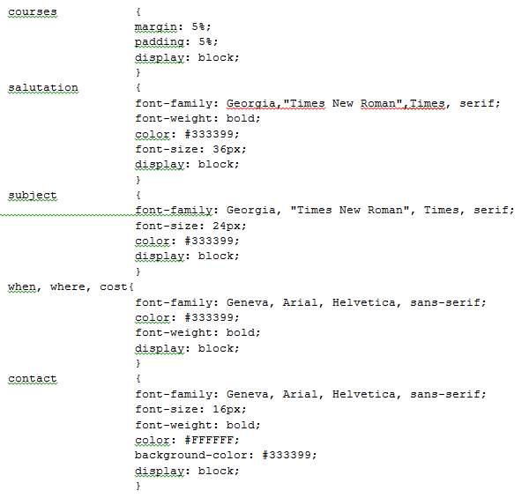

Slide 32


Slide 33
XSL: The Extensible Style Sheet Language
An XSL document specifies how to render the data in an XML document
XSL stands for eXtensible StylesheetLanguage
is a group of three technologies
XSL-FO (XSL Formatting Object): a vocabulary used to specify formatting
XPath (XML Path Language): a language of expressions used to locate structures and data in XML documents
XSLT (XSL Transformation): the technology used to transform XML documents into other documents
XSLT can:
convert data in a standard XML format to SQL statements, tab-delimited text files, or other database formats for data sharing
transform XSLT style sheets into new style sheets
turn web pages (written in XHTML) to a format for handheld devices
add CSS style sheets to XML documents for viewing in a browser

Slide 34
An Example
To transform an XML document using XSLT two tree structures are required
source tree is the XML document that will be transformed
result tree is the XML document that is created
need three files
the XML document consists of data to be displayed
is the source tree
the XSL file does the transformation: transforms XML data into the specified format
In this example the specified format is an HTML page
new page is the result tree
third file is a CSS file that describes how we want the new file displayed
Next slide is the CSS page
Since the XML page is transformed to an HTML page, the styles needed are styles that will be used later, by the XSL file (i.e., HTML elements)
Following slide is the XML page
Third slide is the XSL page

Slide 35
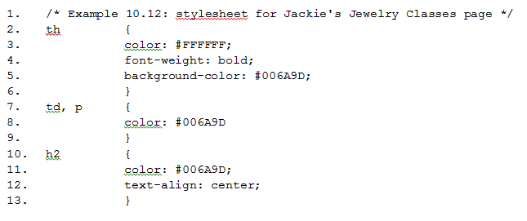

Slide 36
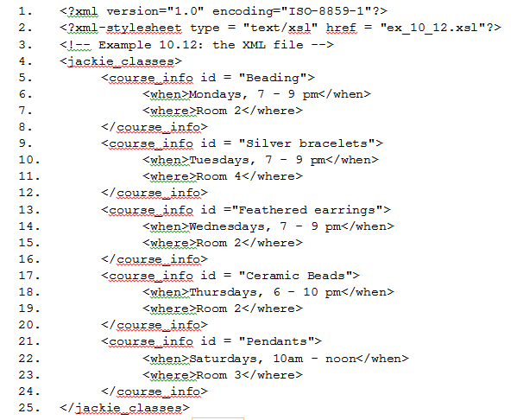

Slide 37
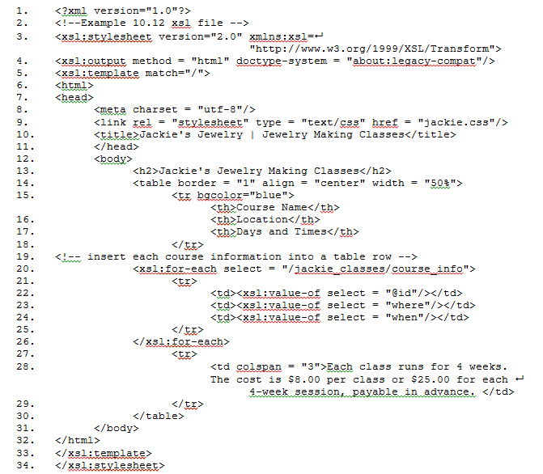

Slide 38

Result

Slide 39
10.5
XML Namespaces and Schemas

Slide 40
XML Namespaces
Namespaces are used to avoid confusion or naming "collisions"
These might occur when two elements have the same name but refer to different things
helpful if one XML document is merged with another
Namespaces must be declared before they are used
namespace declaration is placed in the start tag of an element
applies to that element and its descendants (its child elements)
All XML namespaces use the reserved keyword, xmlns
keyword is an attribute of the element
each namespace prefix binds to a series of characters called a Uniform Resource Identifier (URI)
The URI uniquely identifies the namespace
the web developer creates the URI and the namespace prefix

Slide 41
The Uniform Resource Identifies (URI) and Namespace Declarations
An XML namespace URI references a server but it is not an address that can be visited
purpose is to provide a unique identity for the namespace.
syntax for creating a namespace with the name "beads" might be as follows:
xmlns:beads="http://jackie.com/beads"
It looks like a URL but, if you were to enter this into a browser, it would go nowhere
Why use one's own domain name to define a namespace? It is guaranteed to be a unique string.
A namespace declaration has the following syntax:
xmlns:prefix = "URI"
examples of namespace declarations for Jackie's Jewelry pages:
xmlns:bracelets="http://jackie.com/bracelets"
xmlns:earrings="http://jackie.com/earrings"

Slide 42
Using namespaces in an XSL document
In an XSL document you add the namespaces to identify the values of the XML elements.
For example:
<xsl:for-each select = "/jackie_classes/course" 
xmlns:bead='http://jackie.com/bead' 
xmlns:bracelet='http//jackie.com/bracelet'
xmlns:earrings='http//jackie.com/earrings'
xmlns:mixed = 'http://jackie.com/mixed' >

